Slide 1


BJIT
Academy
SUPPORT 360
PROJECT
Presented by: Arif Mahmud

Slide 2
OVERVIEW
01
02
03
Introduction
Project Description
Designs
04
05
Flows & Codes
Dependencies & Deliverable

Slide 3



INTRODUCTION
Support360 is a comprehensive support management solution designed to streamline
Case and project tracking for teams. This software integrates with Salesforce to provide efficient case handling, project management, and reporting functionalities.
Users can manage their tasks, collaborate with team members, and automate workflows, ensuring smooth business operations

Slide 4
PROJECT DESCRIPTION
Case Management: Track support requests, development tasks, and bug reports.
Project Management: Manage projects with detailed task breakdowns, milestones, and resource allocation.
Dashboards and Reporting: Insights into Case performance, Resource utilization, and project progress.
Automation: Utilizing workflows and Process Builder to streamline operations, Approval Process.
Collaboration: Enable Chatter for team discussions and notifications for task updates.

Slide 5

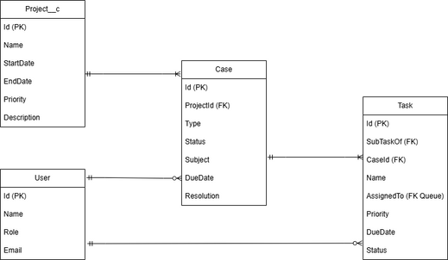
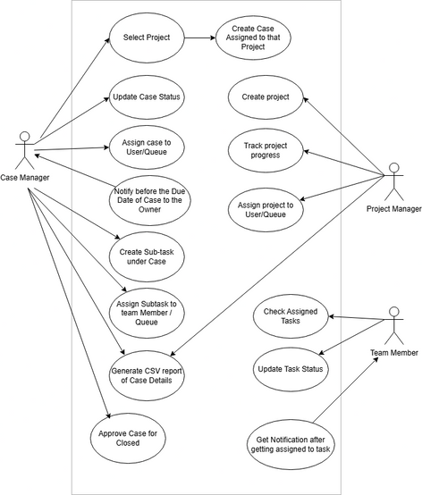
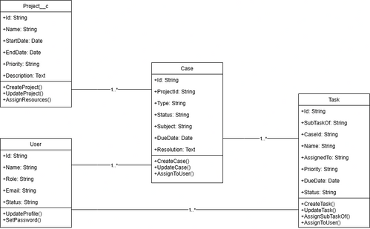
DESIGNS
ERD
Use Case
Class Diagram

Slide 6
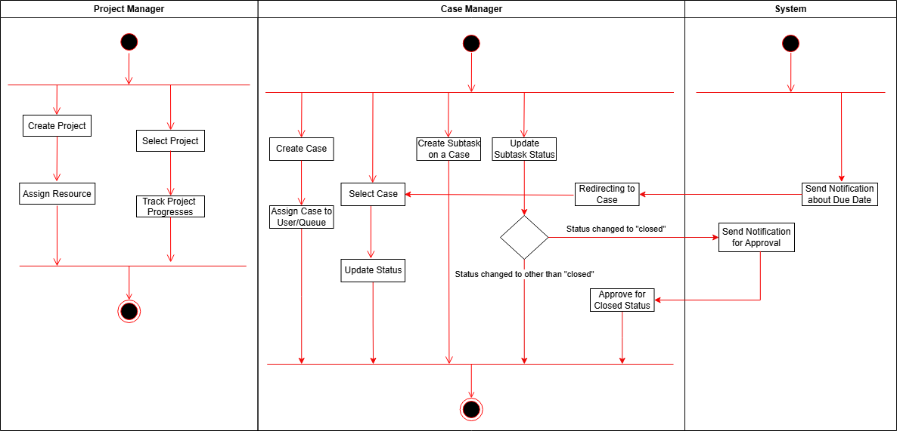
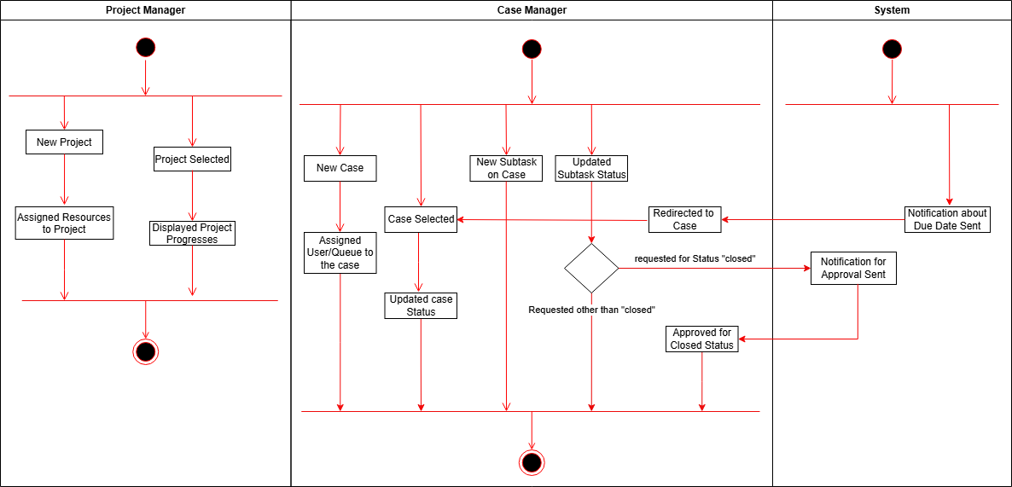
DESIGNS
Activity Diagram
State Diagram

Slide 7
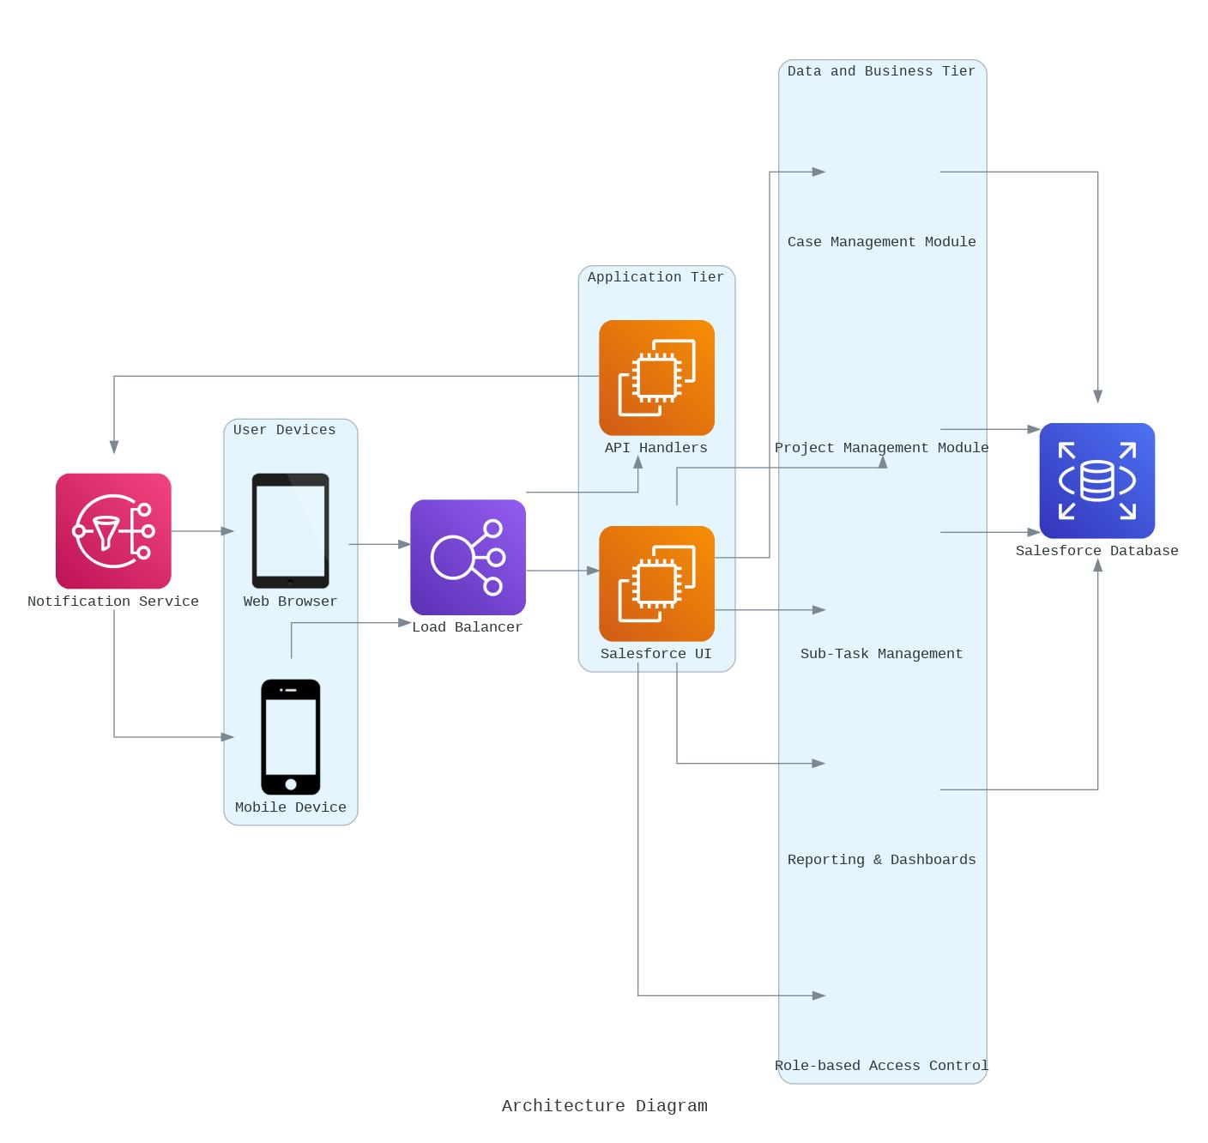
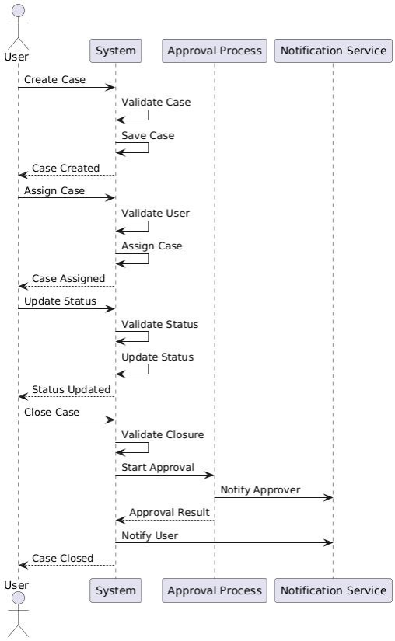
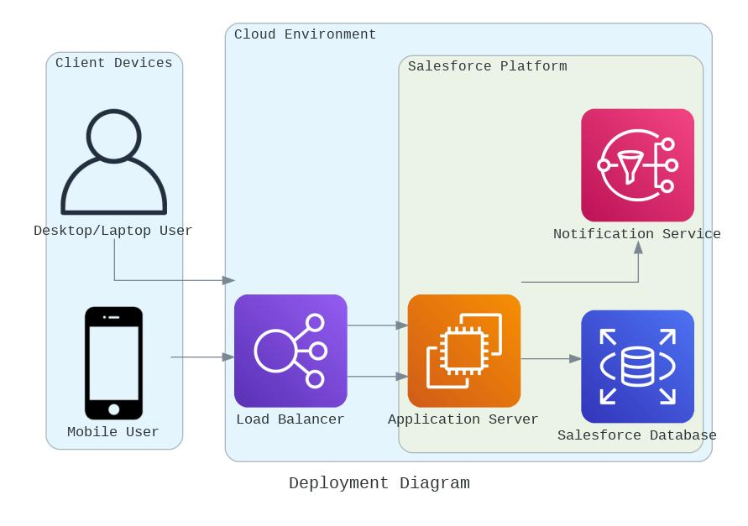
DESIGNS
Architecture Diagram
Sequence Diagram
Deployment Diagram

Slide 8
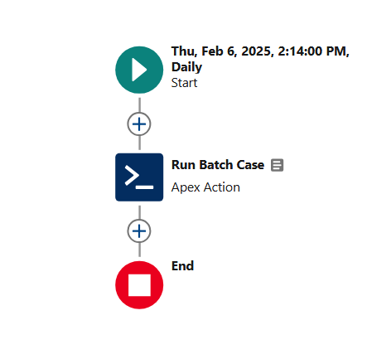
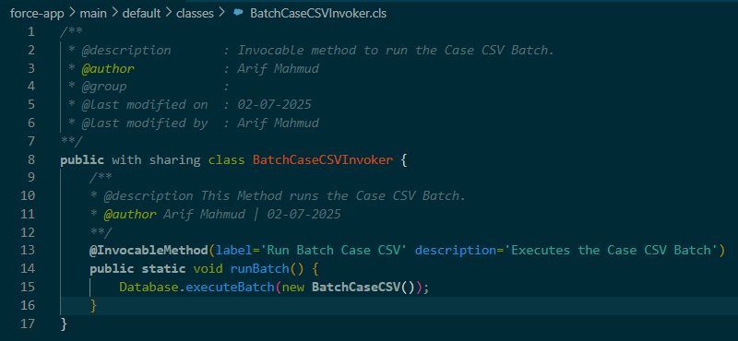
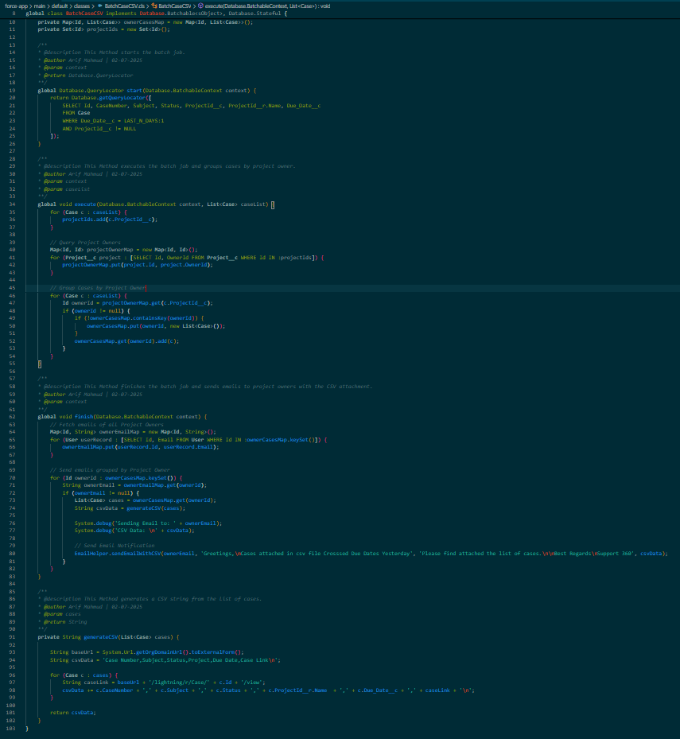
FLOWS & CODES
👉
↙
Missing Due Date

Slide 9
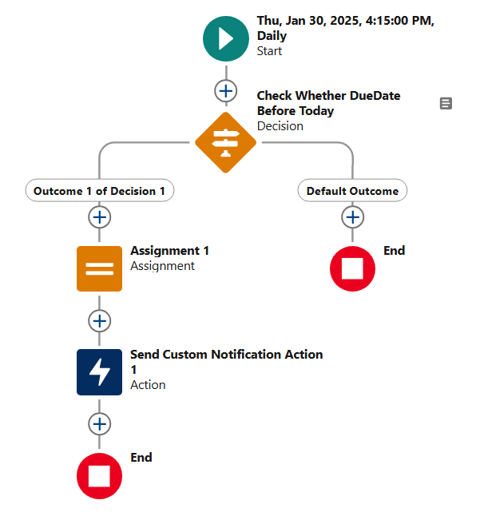
FLOWS & CODES
Notify Case Manager/ Task Manager One Day Before Due Date

Slide 10
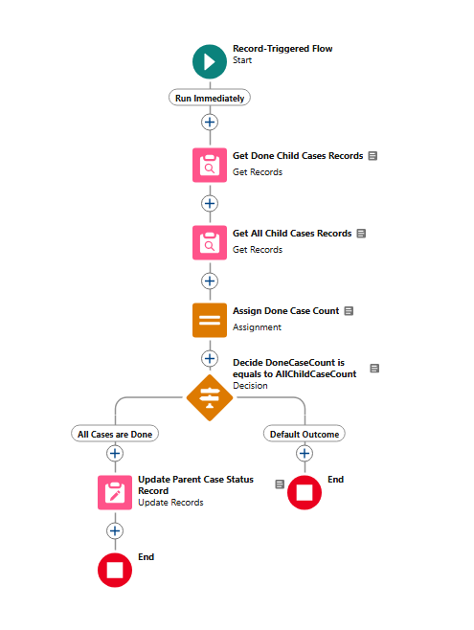
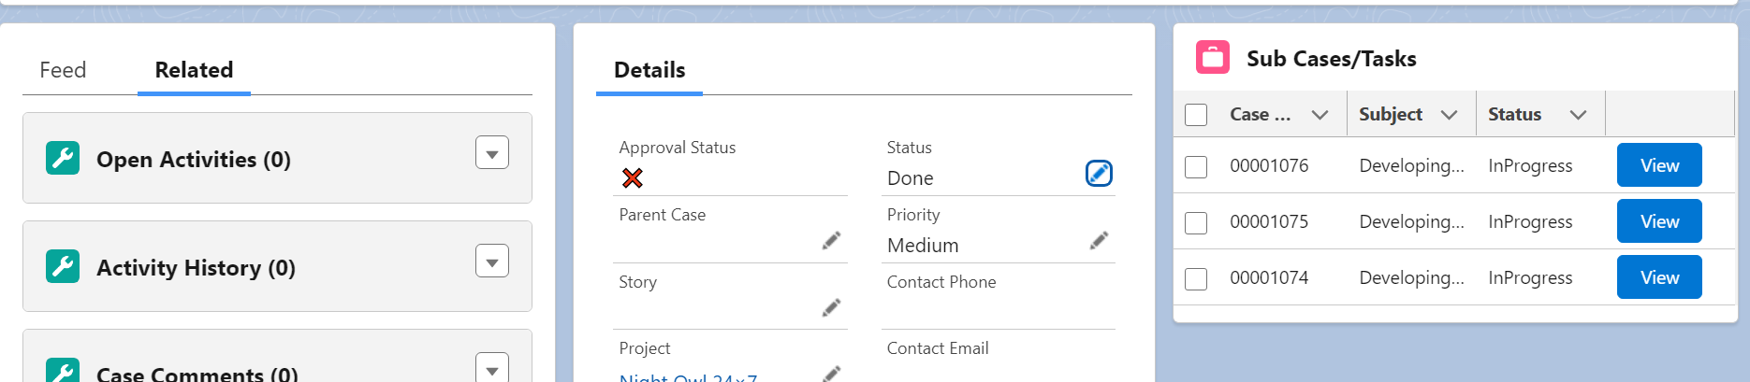
FLOWS & CODES
Parent Task/Case’s Status will be If all of it’s Sub Task/Case’s Status’ are Done

Slide 11
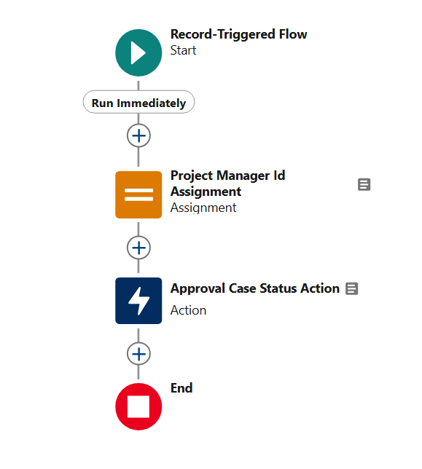
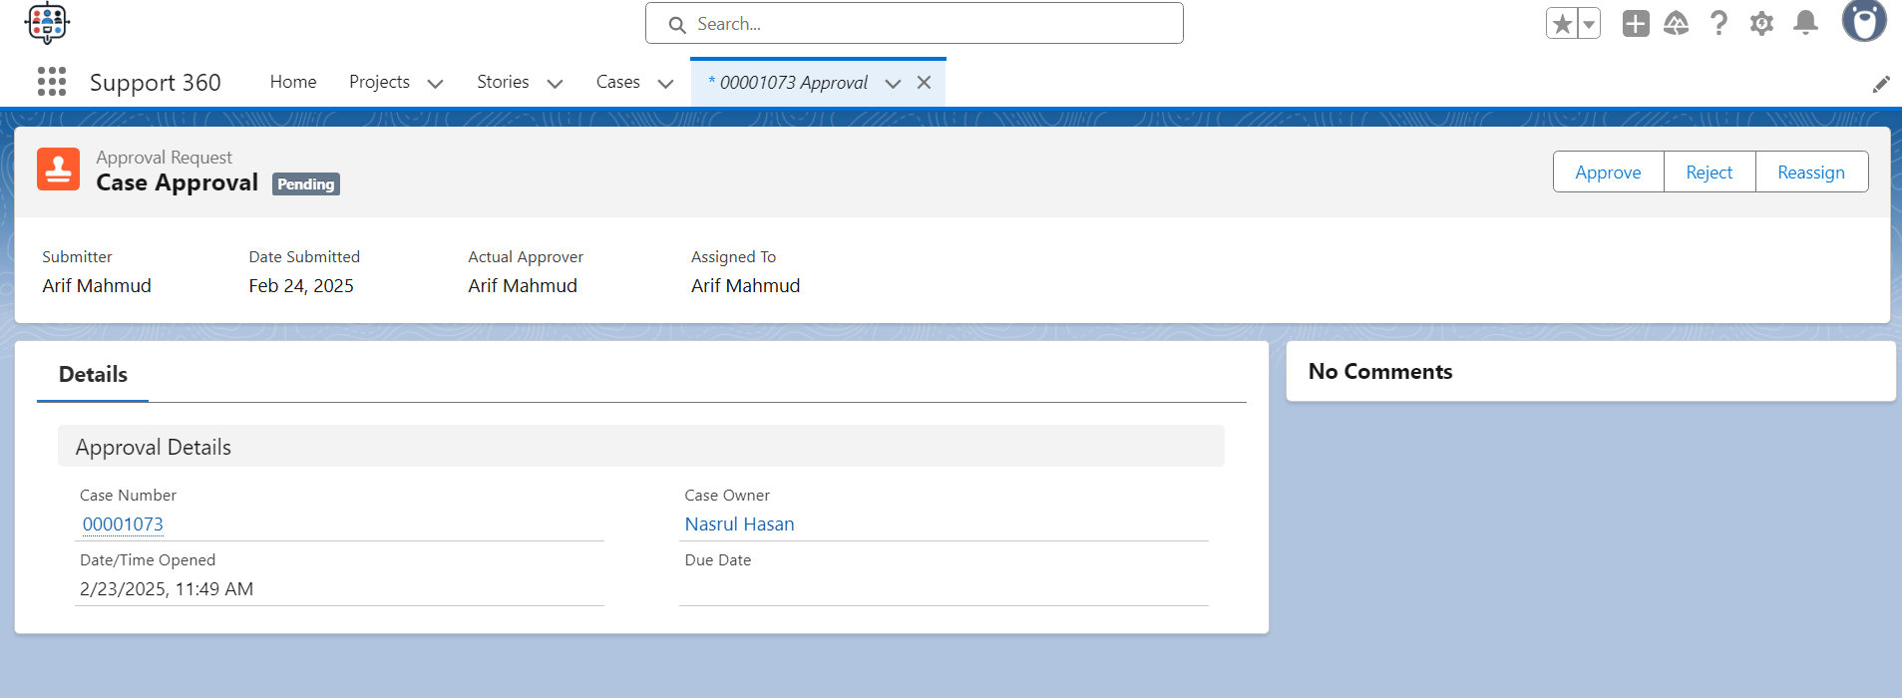
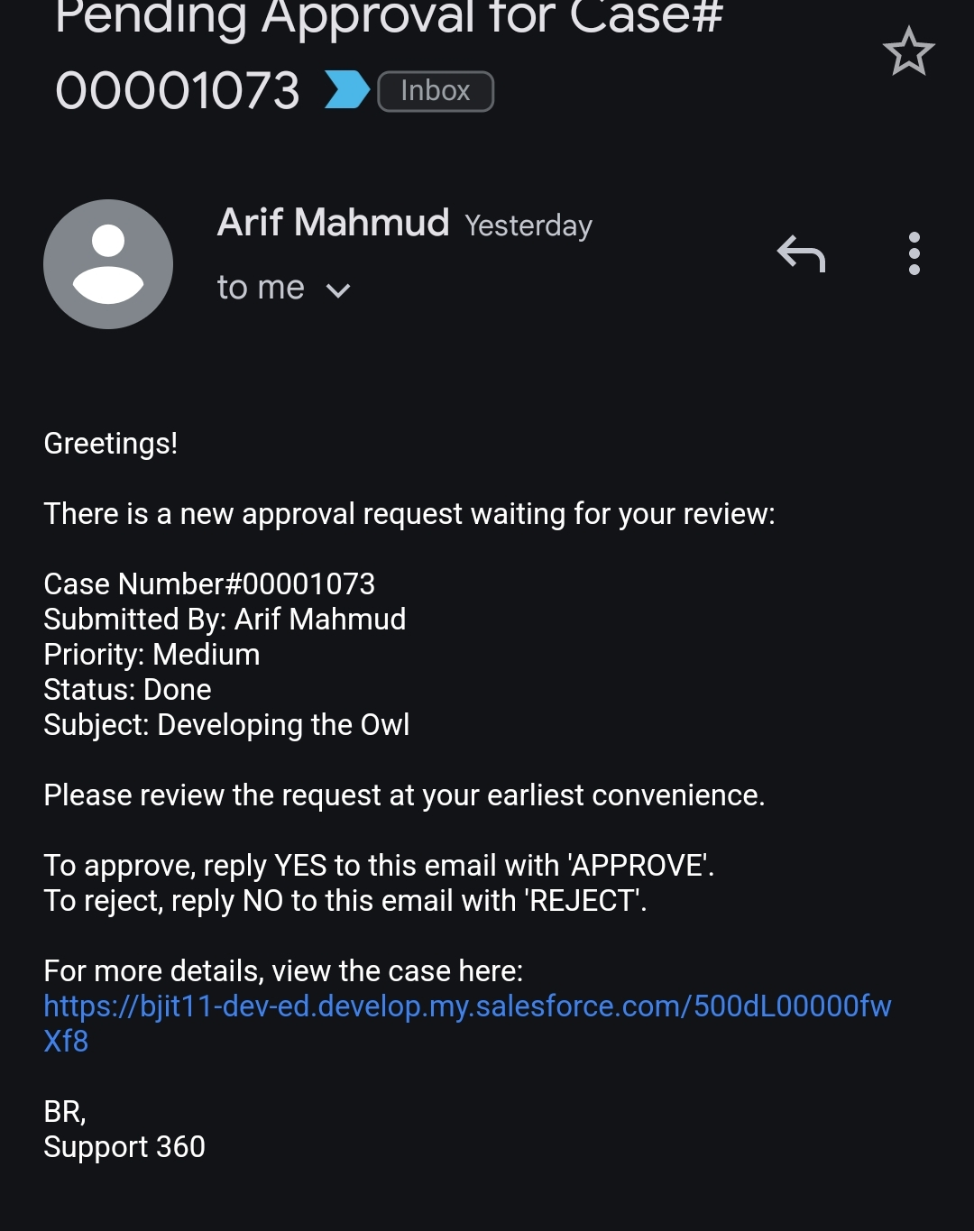
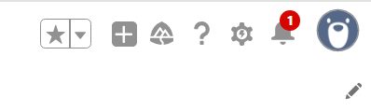
FLOWS & CODES
Whenever Case/Task Manager Set Status Done it will Send Notification, Email To the Project Manager For Approval Note: User Can Confirm by Reply Email, Can Re Assign

Slide 12
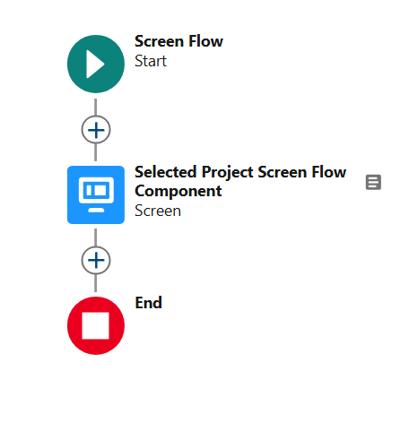
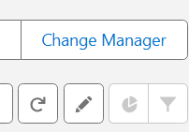
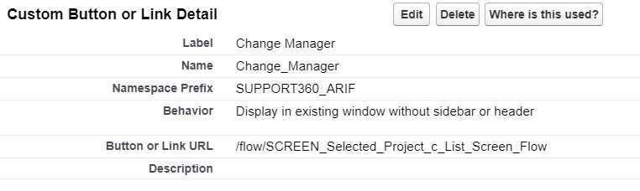
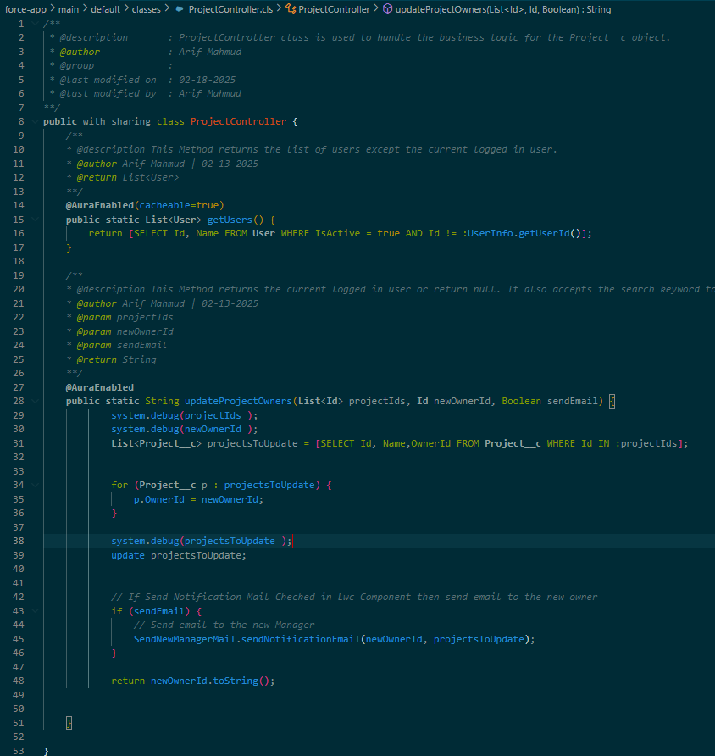
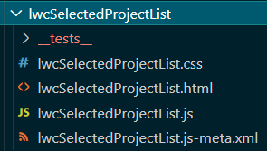
FLOWS & CODES
Button in Project__c ListView which will Change Selected Project’s Manager

Slide 13
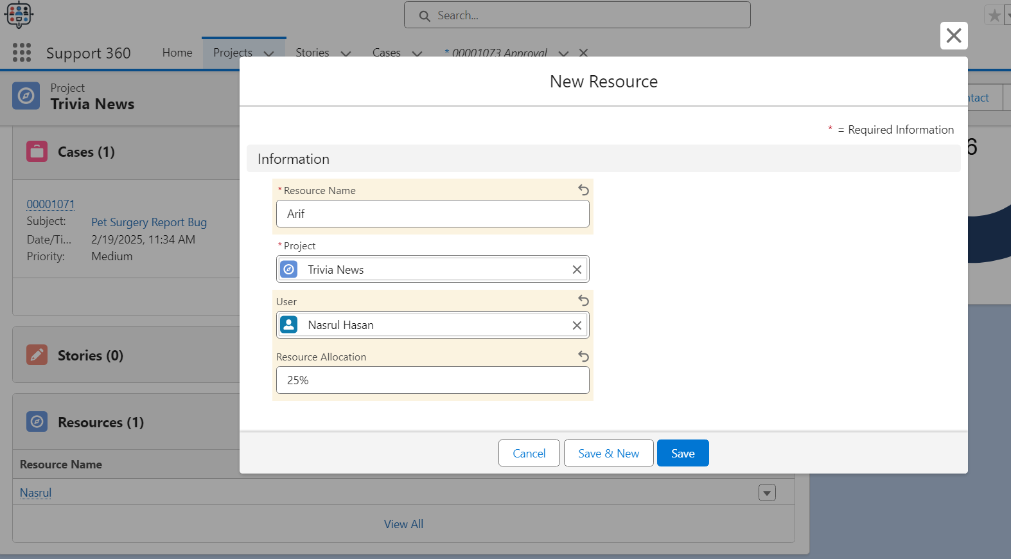
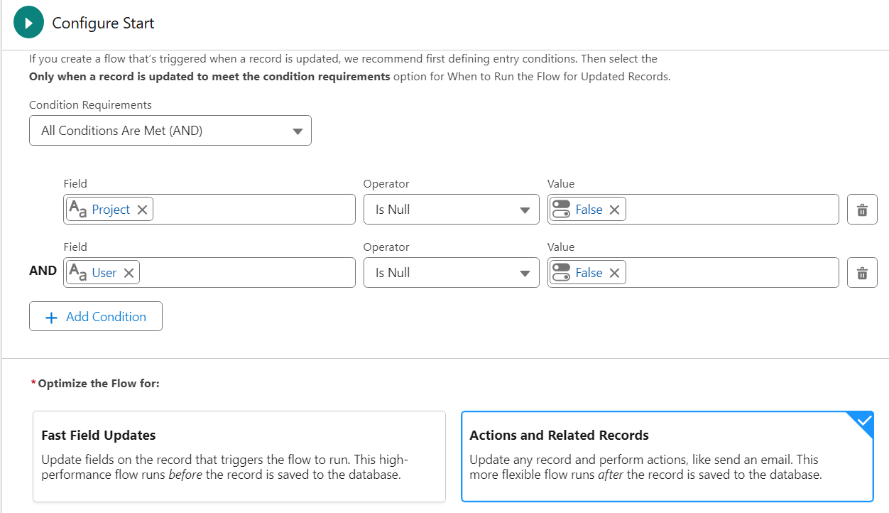
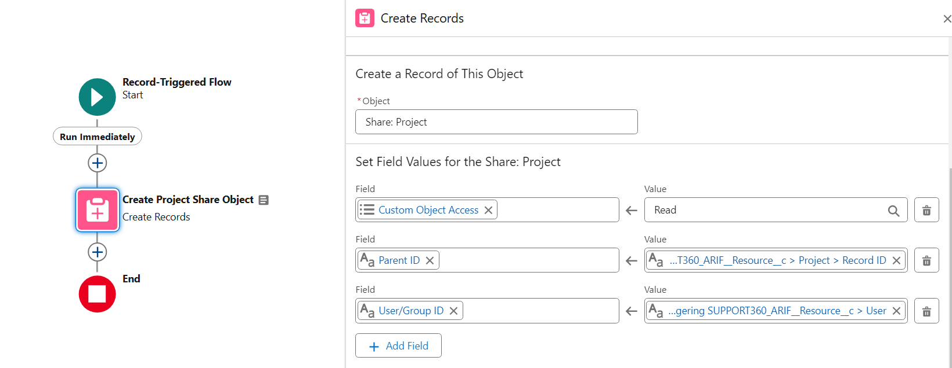
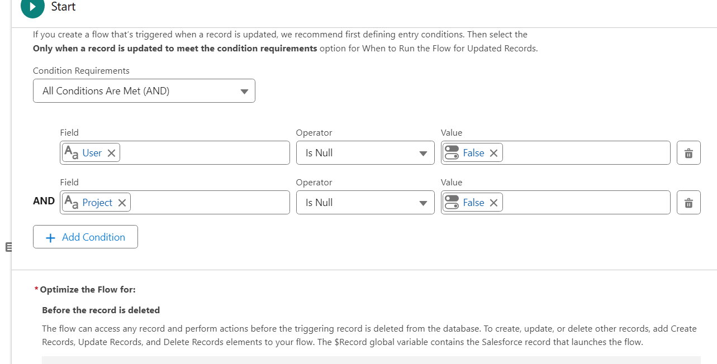
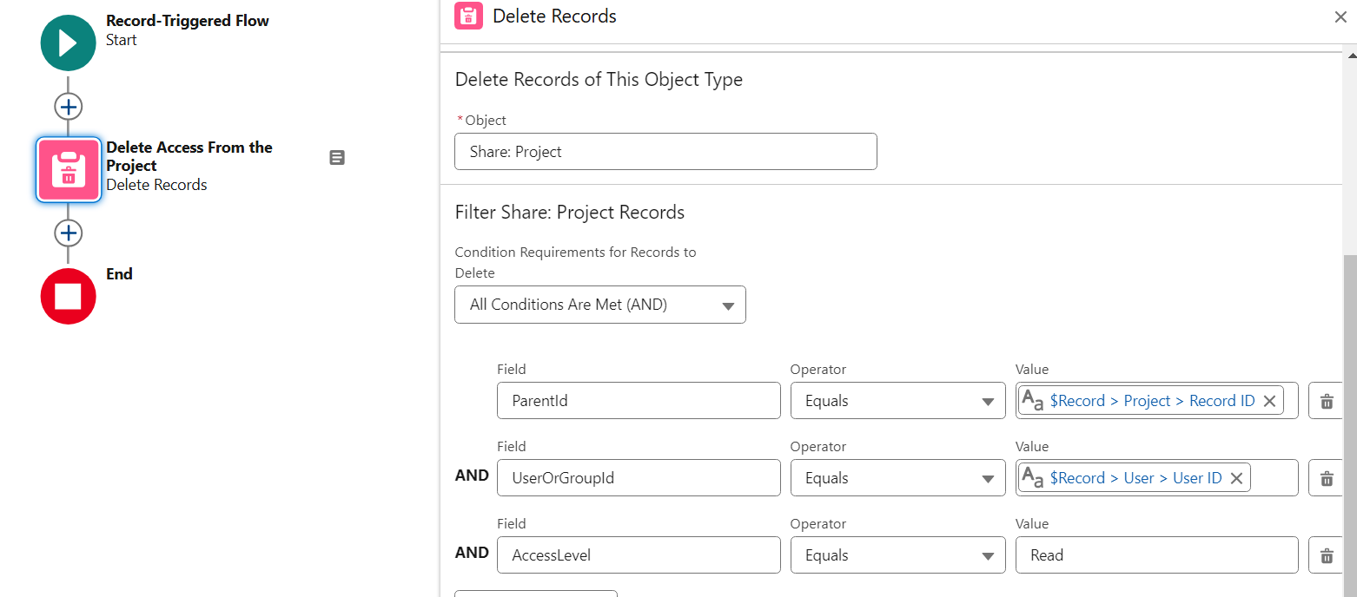
FLOWS & CODES
Allocating Resource to a Project, Creating a Resource Object as Junction Object, then create Project__c__Share object and give the Team Member View Only Access
Deleting Project__c__Share Object to Remove the Allocation

Slide 14

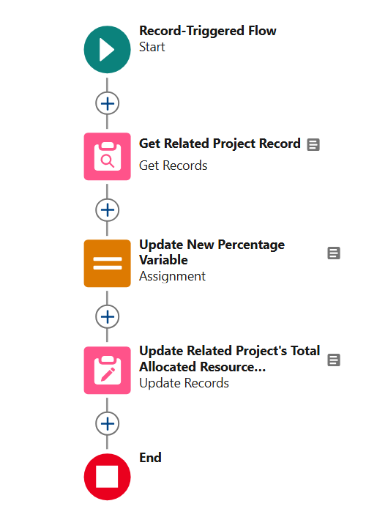
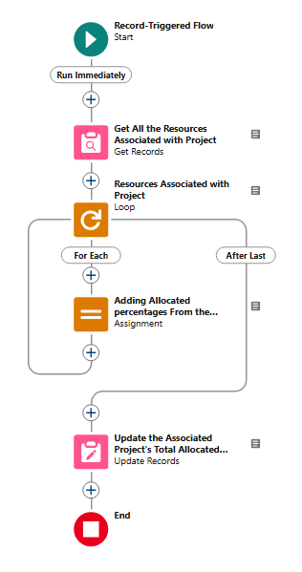
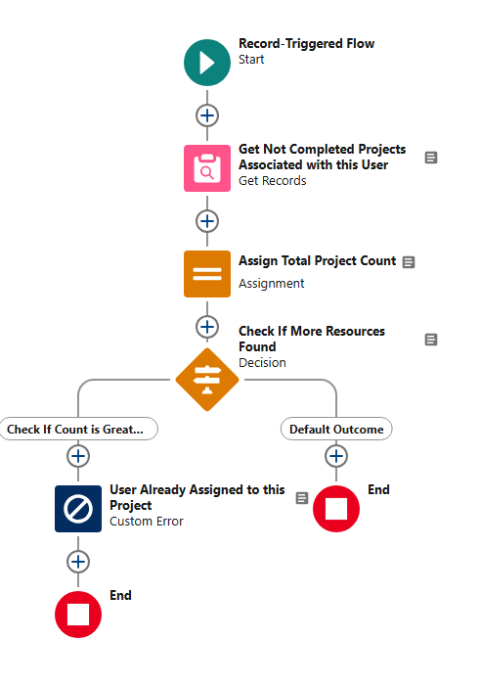
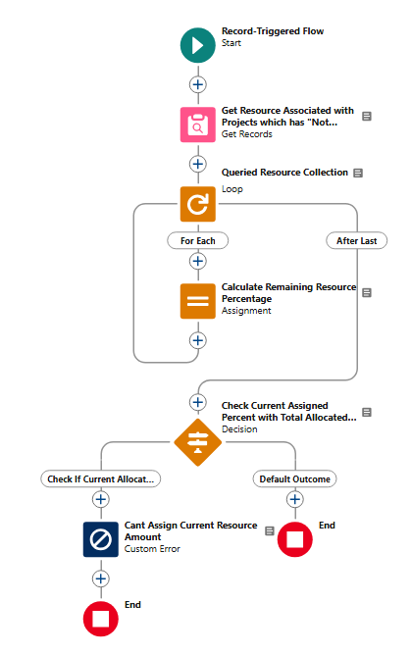
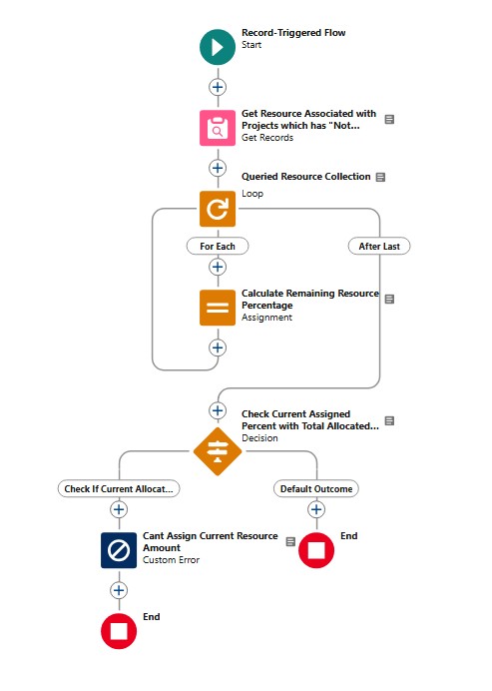
FLOWS & CODES
Resource Allocation, Deletion, Updates, Prevent Adding Duplicate Resource, Limiting User’s Resource Allocation

Slide 15
DELEVARABLES
User Manual
Installation Package Link
Release Note
SRS
Test Classes & Evidence
Release Note

Slide 16

BJIT
Academy
Thank you

